Slide 1
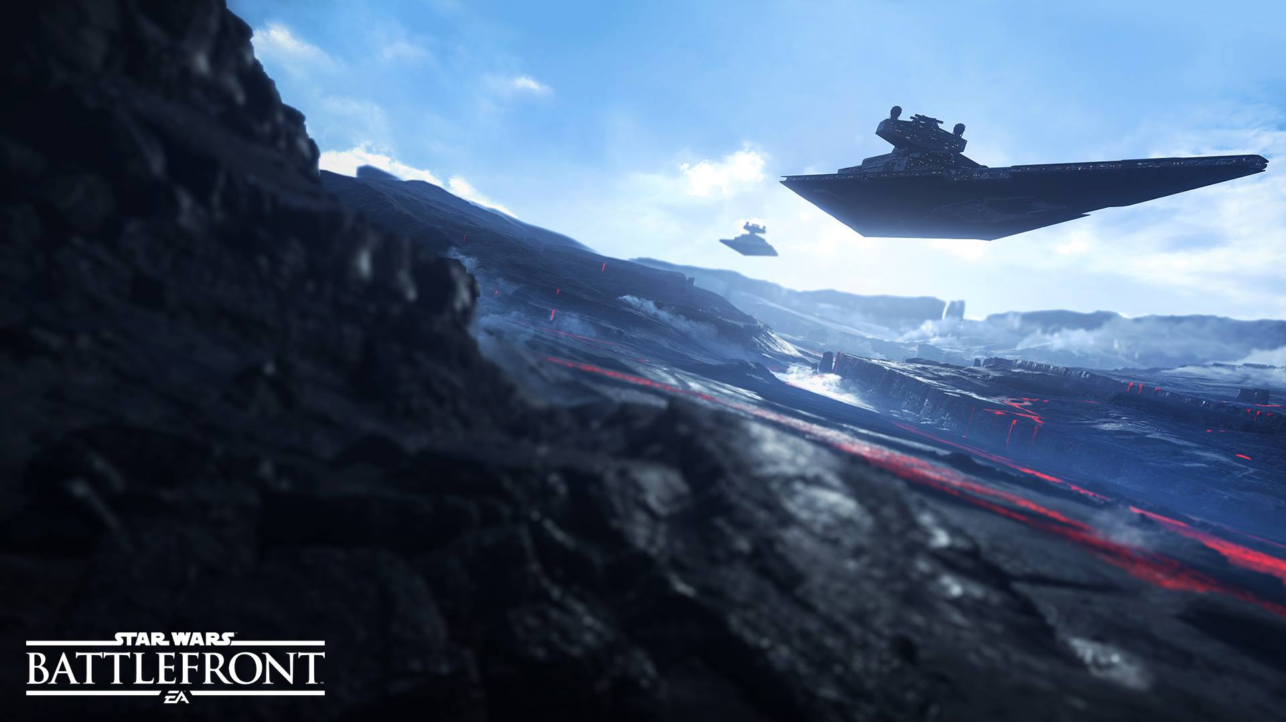
SPACE WARS Game Pitch for CSCE 4220 Spring 2016
Jason Hoang

Slide 2
Notation
[Req #]
These are all of the requirements of the game that need to be in the game for completeness.
[Func #]
These are all of the functions that show which aspects of the game will actually change how gameplay works and is seen by the player.

Slide 3
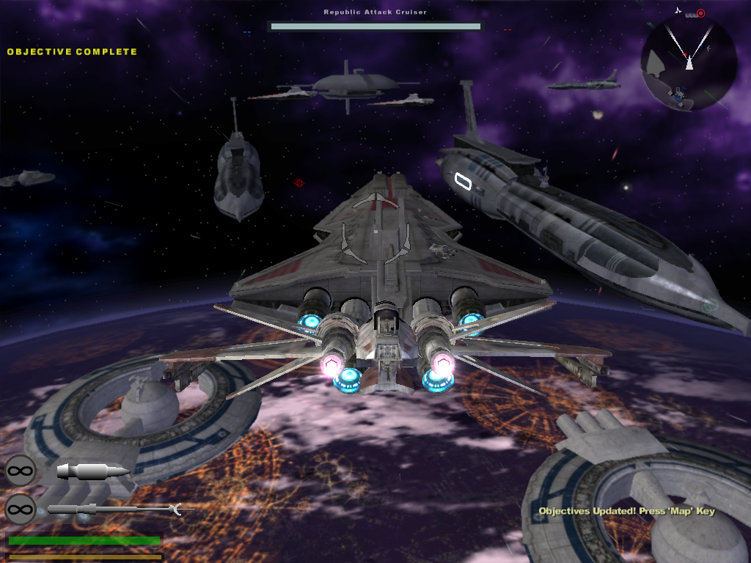
General
3D Starfighter shooter [Req 1]
Real Time [Req 2]
Dynamic Space Battlefield
Play divided into two teams [Req 3]
A battle of Attrition
Player and the AI verses the enemy AI
Battlefield will consist of at least 2 main star cruisers, a few corvette class ships for each side, and several Starfighters playable by the player. [Req 4]
AI will spawn at random intervals throughout the game. [Req 5]
Star cruisers and corvettes will be operated by the AI. [Req 6]

Slide 4
General (Cont.)
Play will be reserved to Single player to start. [Req 7]
The player can choose from 2 ships to play as throughout the game.
Standard Starfighter [Req 8]
Bomber [Req 9]
The game is over when either team scores enough attrition points to ultimately defeat the enemy, and there will be no time limit. [Req 10]
The player dying rewards points to the enemy team, but doesn’t end the game. [Func 1]
There will be destroyable objectives on each side to score additional points. [Func 2]
Shield generator
Turrets
Etc.

Slide 5
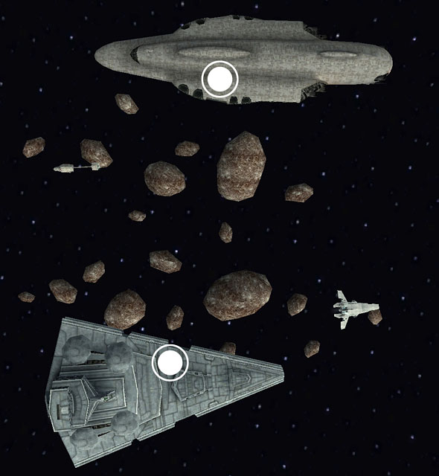
The World
The sky box will be set in space. [Req 11]
There will be stars in the distance
And possibly some planets or moons
XYZ Plane
The Starfighters and Starships will not be affected by gravity.
There will be boundaries for the playing field so that the game is focused on the battle. [Func 3]
Space debris and asteroids could litter the playing field as another obstacle for the player to avoid.

Slide 6
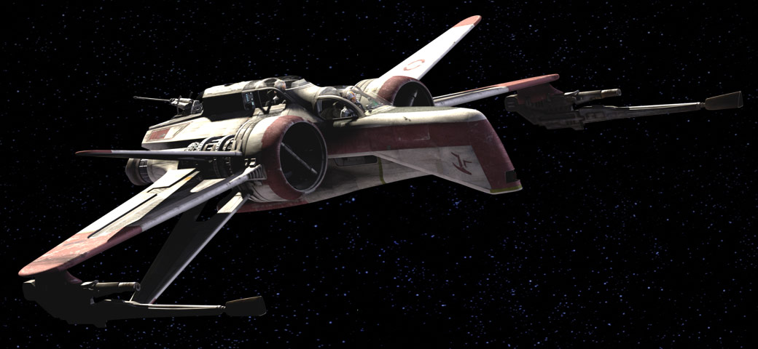
Player Character (PC)
Star Pilot [Req 12]
Able to fly 2 different ships [Req 13]
Standard Starfighter – fast with high powered lasers, and medium powered shields, can also fire torpedoes[Func 4]
Bomber – Slow with low powered lasers, but powerful bombs and shields [Func 5]
Takes damage from collisions(usually lethal). [Func 6]
Can be shot down by any enemy lasers and torpedoes.[Func 7]

Slide 7
Player Character (Cont.)
Shields will have a regeneration rate while flying around no matter if in combat or out. [Func 8]
The regeneration will be stunned for about 2 seconds if fired upon during regen.
Regeneration rate will be consistent throughout the match.
The player is dead when both the shield and hp bars are at 0%. The player will then have an explosion animation for death. [Req 14]
The player will have a short cooldown timer for them to change ships before re-entering the battle. [Func 9]
The player will also have a virtually unlimited number of lives until either side wins the battle. [Req 15]

Slide 8
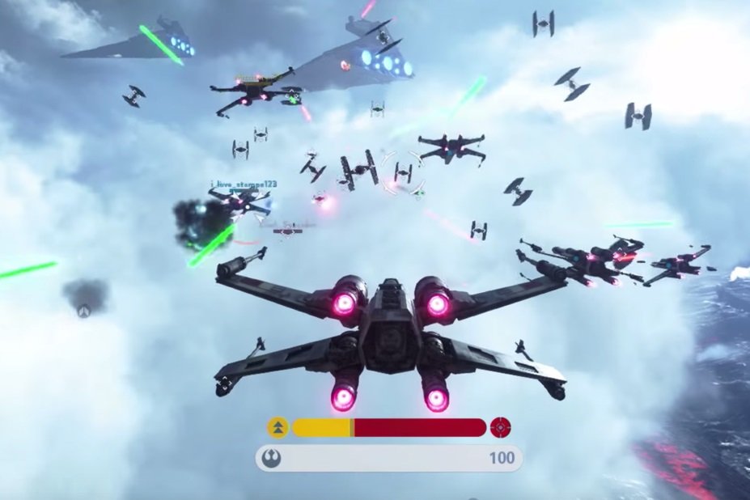
Camera
One mode:
3rd Person [Req 16]
Third person mode will be placed behind and above the ship. [Req 17]
You will be able to see most of the exterior of the ship. [Func 10]
The camera will avoid obstructions by other starships and star cruisers whenever the player flies near them. [Func 11]

Slide 9
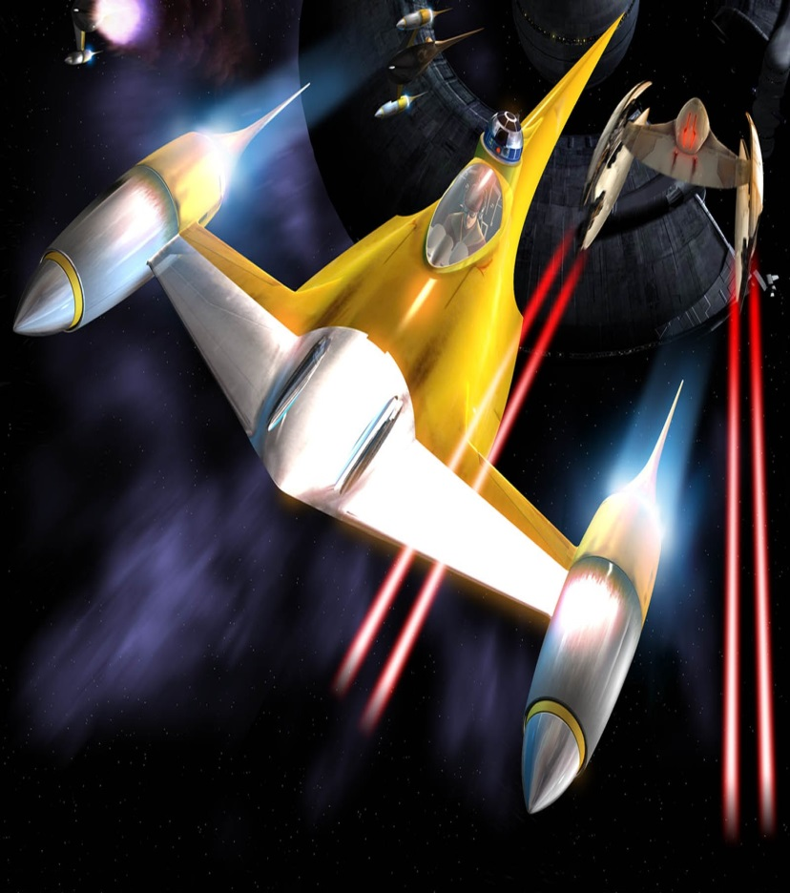
Non Player Character (NPC)
The NPCs will control all of the other Starfighters fighting within the battle along with controlling the corvettes and star cruisers weapons. [Req 18]
NPC Starfighters consist of the standard fighter and the bomber, which have the same stats as the player ships.
NPC turrets will have medium powered lasers with low accuracy when the player is far away from them, but higher when the player is closer.
They will actively be searching for any enemy team Starfighters and starship objectives. [Func 12]
Turrets will stay stationary on the starships. [Func 13]
Each NPC controlled ship/turret will have a death animation. [Req 19]

Slide 10
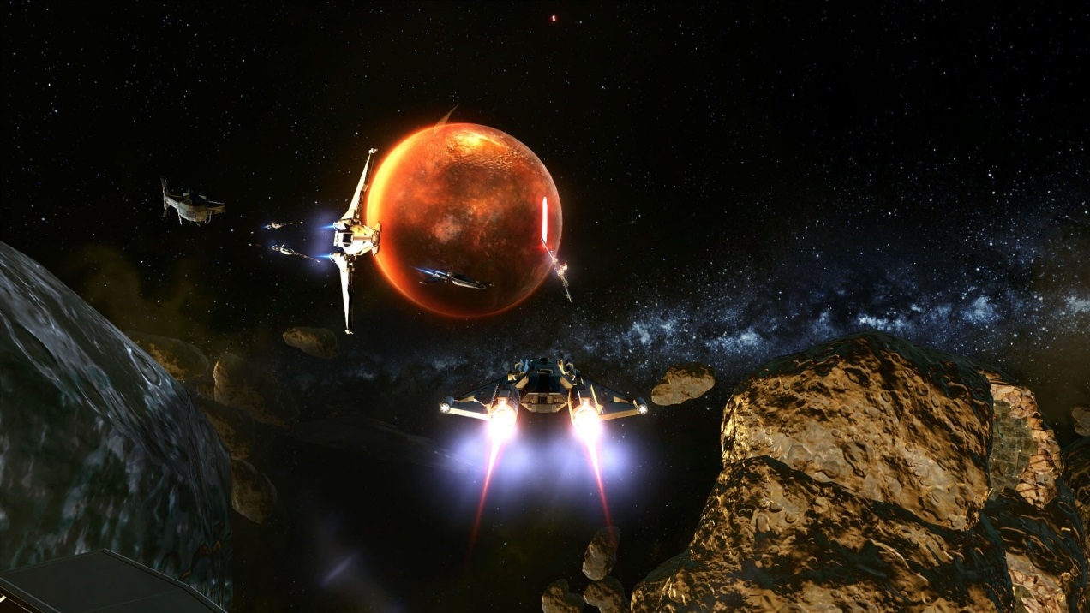
Furniture
Space debris from previous space battles . [Req 20]
These can be collided with and cause the player to self destruct. [Func 14]
These pieces of furniture can move across the battlefield based on player or NPC interaction(crashing). [Func 15]
Minor asteroids. [Req 21]
Distant planets and moons. [Req 22]
Everything will spawn in a fixed location for each game, and will move based on dynamic interaction. [Func 16]

Slide 11
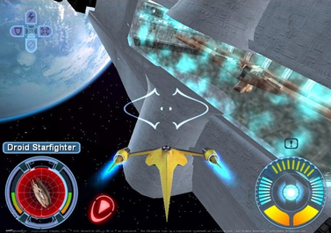
User Interface
Controller will control the Player. [Req 23]
Unrealistic space flight will be simulated. [Func 17]
It will feel like jet fighters on earth, but in space.
Damage to the player will appear on the player character directly with a red flashing outline of the ship along with a decrease to either the shield or the hp bars. [Req 24]
The screen will display:
The health bar, shield bar [Func 18]
Attrition points for each team [Func 19]
Space map [Func 20]
Targeted enemy health and shield bars [Func 21]
Torpedo/bomb cooldown timer. [Func 22]

Slide 12
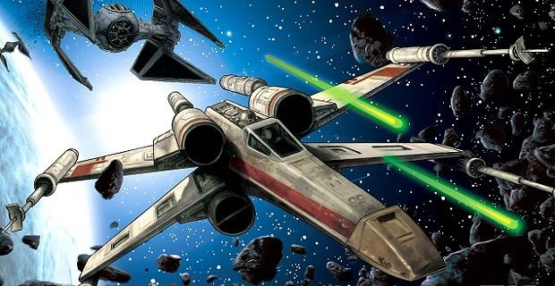
Lasers
High-Powered [Req 25]
Standard Starfighter
Low-Powered [Req 26]
Bomber
Medium-Powered [Req 27]
Turrets
Can be beams and short burst lasers [Func 23]
Varies on the type of turret
Enemy lasers are Red. [Req 29]
Allied an player lasers are Blue. [Req 30]

Slide 13
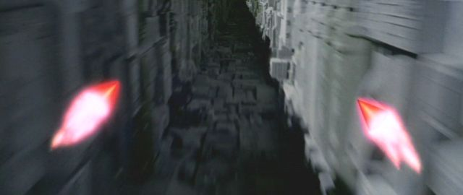
Torpedoes
Carried by Both Starfighters. [Req 31]
Slower than lasers in terms of speed. [Func 24]
Can lock on to the target and track them until they collide with the target or any other crash-able obstacle in the way. [Func 25]
Penetrates shields. [Func 26]
Explosion animation on collision. [Req 32]

Slide 14
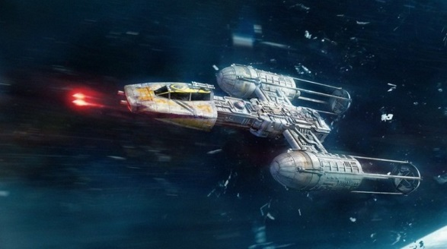
Bombs
Launched from the bottom the bomber. [Func 27]
Falls as if it is affected by gravity until it collides with something. [Req 33]
Deals high damage. [Func 28]
Explosion animation on collision. [Req 34]

Slide 15
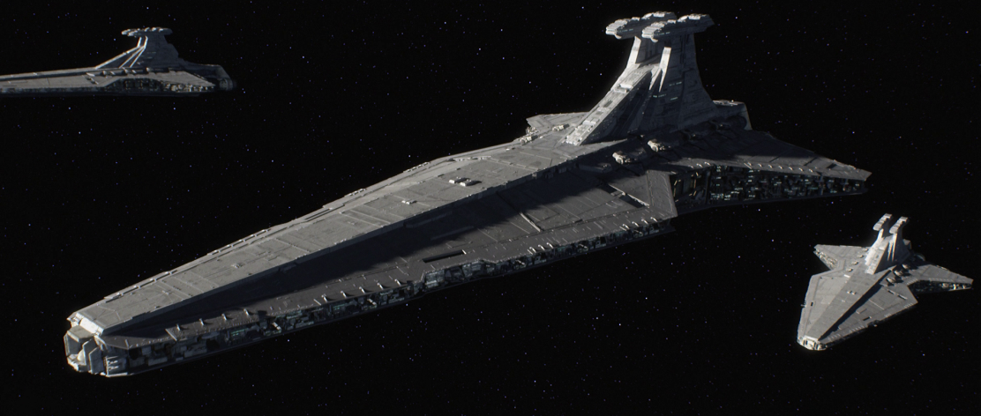
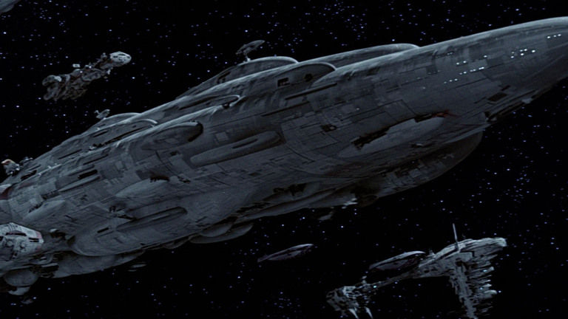
Star Cruisers
Destroyable Objectives:
Shield Generator [Req 35]
Engines [Req 36]
Multiple turrets [Req 37]
The Command Bridge [Req 38]
Life Support [Req 39]
Weapon Systems [Req 40]
Notable Locations:
Hanger Bay – where ships will spawn from [Func 29]

Slide 16
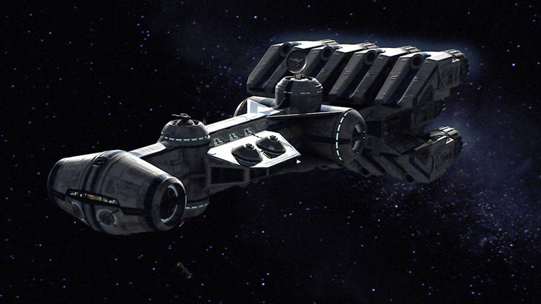
Star Corvettes
Destroyable objectives:
Turrets [Req 41]
Engines [Req 42]
Shield Generator [Req 43]
Main Hull [Req 44]

Slide 17
Possible Additions
Multiplayer
Additional Starfighters
Additional turret types
Maybe a ground game like Battlefront 2
Make the star cruiser turrets controllable

